Slide 1

COST Unit 4
Small Sampling Theory

Slide 2
Small Sampling
Small sample size
N < 30
Approximation becomes inaccurate with small sampling size
Distributions-
Student’s t distribution
F distribution
Chi square distribution

Slide 3

Degrees of freedom
The number of independent pieces of information that went into calculating the estimate.
Degrees of freedom = $N−1$

Slide 4

Student’s t distribution
z score, or z statistic is replaced by a suitable t score, or t statistic.
$t=\frac{\overline{X}−μ}{σ_{\overline{x}}}$ $\sqrt{N−1}$

Slide 5
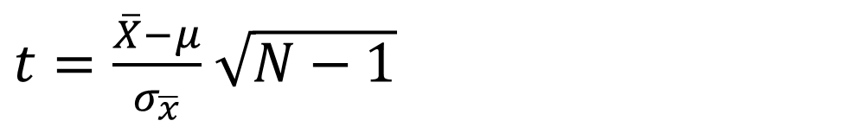
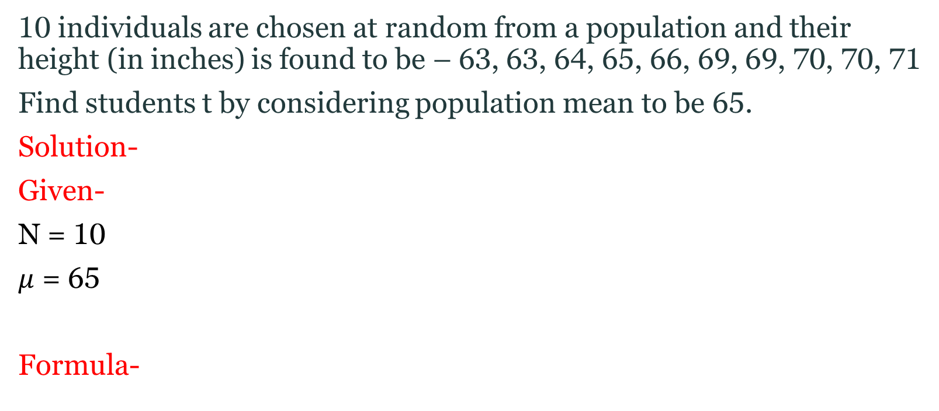
Question
10 individuals are chosen at random from a population and their height (in inches) is found to be – 63, 63, 64, 65, 66, 69, 69, 70, 70, 71
Find students t by considering population mean to be 65.
Solution-
Given-
N = 10
$μ$ = 65
Formula-
$t=\frac{\overline{X}−μ}{σ_{\overline{x}}}$ $\sqrt{N−1}$

Slide 6
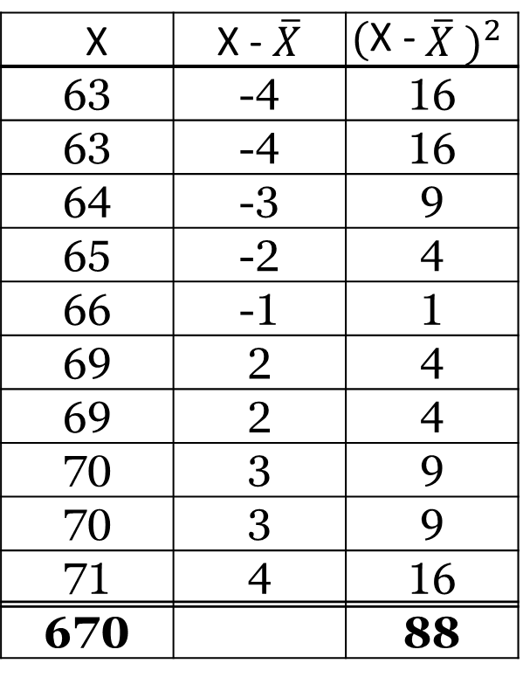


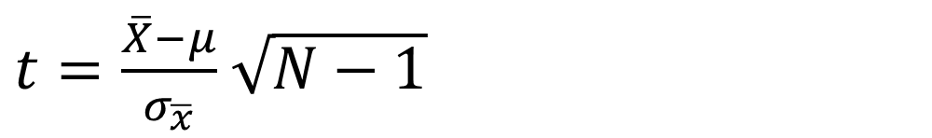
Cont..
X | X - $\overline{X}$ | $${\text{(}\text{X}\text{ − }\overline{X} )}^{2}$$
63 | -4 | 16
63 | -4 | 16
64 | -3 | 9
65 | -2 | 4
66 | -1 | 1
69 | 2 | 4
69 | 2 | 4
70 | 3 | 9
70 | 3 | 9
71 | 4 | 16
670 |  | 88
$\overline{X}=\frac{\text{63}\text{+}\text{63}\text{+}\text{64}\text{+}\text{65}\text{+}\text{66}\text{+}\text{69}\text{+}\text{69}\text{+}\text{70}\text{+}\text{70,}\text{+}\text{71}}{10}$= 67
$σ_{\overline{x}}=\sqrt{\frac{{(X−\overline{X})}^{2}}{N}}$ = 2. 9664
$t=\frac{\overline{X}−μ}{σ_{\overline{x}}}$ $\sqrt{N−1}$
$$t=2.0226$$

Slide 7
Question
Compute student’s t for data below-
-4 -2 -2 0 2 2 3 3
Take mean of universe to be zero.

Slide 8
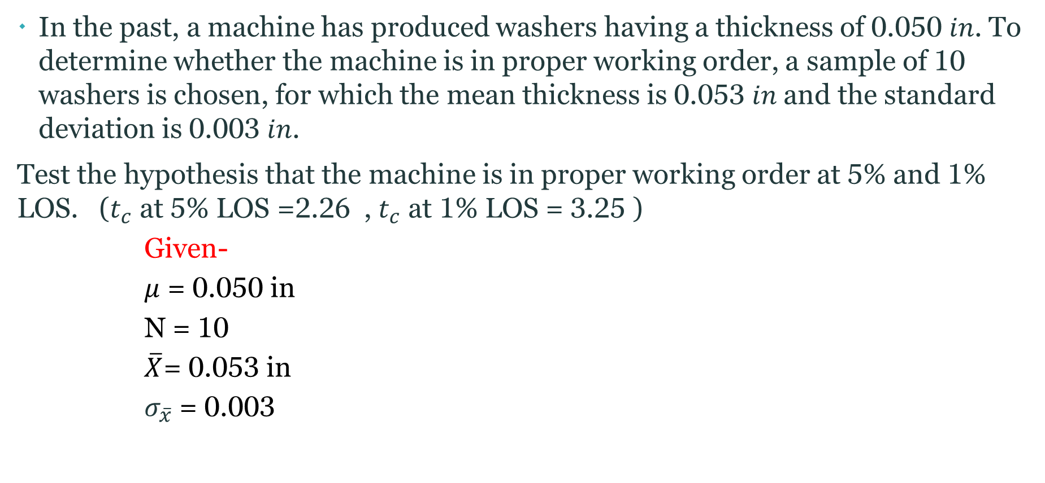
Question
In the past, a machine has produced washers having a thickness of 0.050 𝑖𝑛. To determine whether the machine is in proper working order, a sample of 10 washers is chosen, for which the mean thickness is 0.053 𝑖𝑛 and the standard deviation is 0.003 𝑖𝑛.
Test the hypothesis that the machine is in proper working order at 5% and 1% LOS. ($t_{c}$ at 5% LOS =2.26 , $t_{c}$ at 1% LOS = 3.25 )
Given-
$μ$ = 0.050 in
N = 10
$\overline{X}$= 0.053 in
$σ_{\overline{x}}$ = 0.003

Slide 9


Cont..
Propose Hypothesis-
$Formula−$
$t=\frac{\overline{X}−μ}{σ_{\overline{x}}}$ $\sqrt{N−1}$
$t=$ 3

Slide 10

Cont..
At 5% LOS
$t_{c}$= 2.26
t = 3
As t > $t_{c}$ → Reject Ho at 5% LOS
At 1% LOS
$t_{c}=3.25$
t = 3
As t < $t_{c}$ → Accept Ho at 1% LOS

Slide 11

Question
In a city, it is claimed that average IQ of students is 102. The intelligence quotients (IQs) of 16 students from one area of a city showed a mean of 107 and a standard deviation of 10.
Test the claim at 5% LOS. ($t_{c}$ at 5% LOS =2.144)

